Slide 1
SHACKS LAB ASSIGNMENT
HOUSE PRICE PREDICTION
TANMAY PATIL

Slide 2
CONTENT :-
METHODOLOGY
OBJECTIVE
EXPLORATORY DATA ANALYSIS
MODEL FITTING
INFERENCE

Slide 3






Methodology
Objective Under Study
Data Collection
(Secondary data)
Data Processing
EDA
Model Fitting
Inference

Slide 4
OBJECTIVES
TO IDENTIFY THE FACTORS DRIVING HOUSE PRICING
USE APPROPRIATE STATISTICAL TECHNIQUES
PERFORM APPROPRIATE ANALYSIS OVER DATA
FIT THE APPROPRIATE PREDICTIVE MODEL

Slide 5

DATASET
SECONDARY DATA

Slide 6
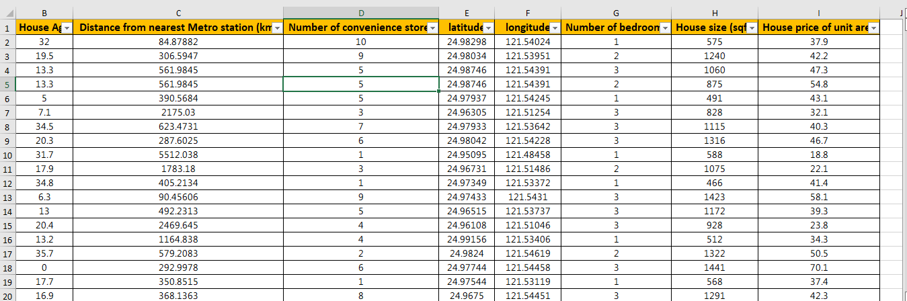
SMALL SNAPSHOT OF DATA

Slide 7


EXPLORATORY DATA ANALYSIS

Slide 8
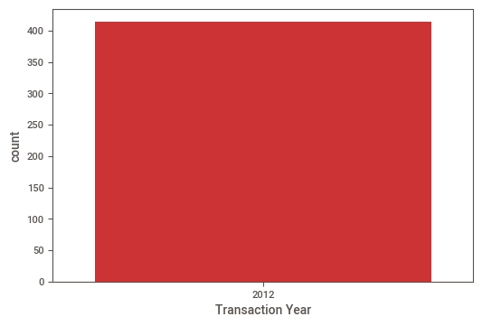
COUNT PLOT
I have plot the count plot of the ‘Transaction Year” Variable from which I understood that, the all Transactions happened in year 2012.
So I dropped the ‘Transaction Year” Variable that it is not providing any information other than that.

Slide 9
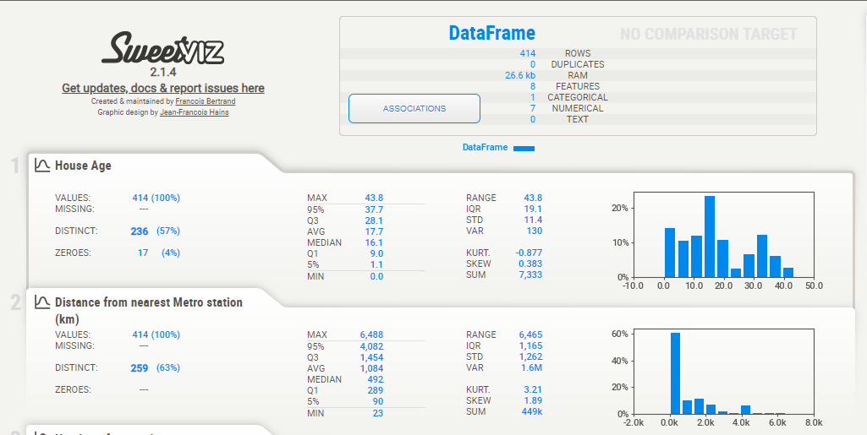
OTHER INSIGHTS OF DATA

Slide 10
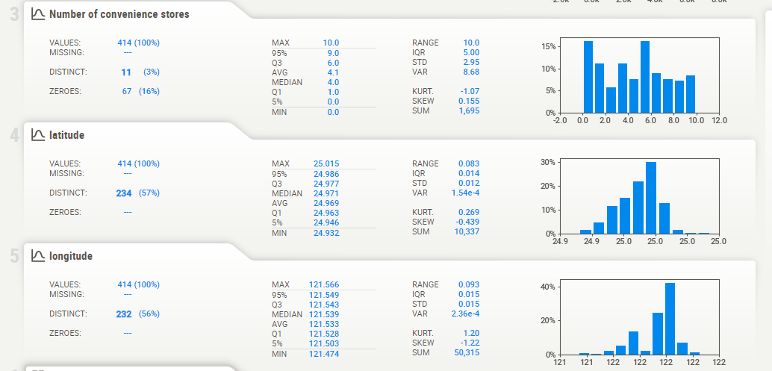

Slide 11
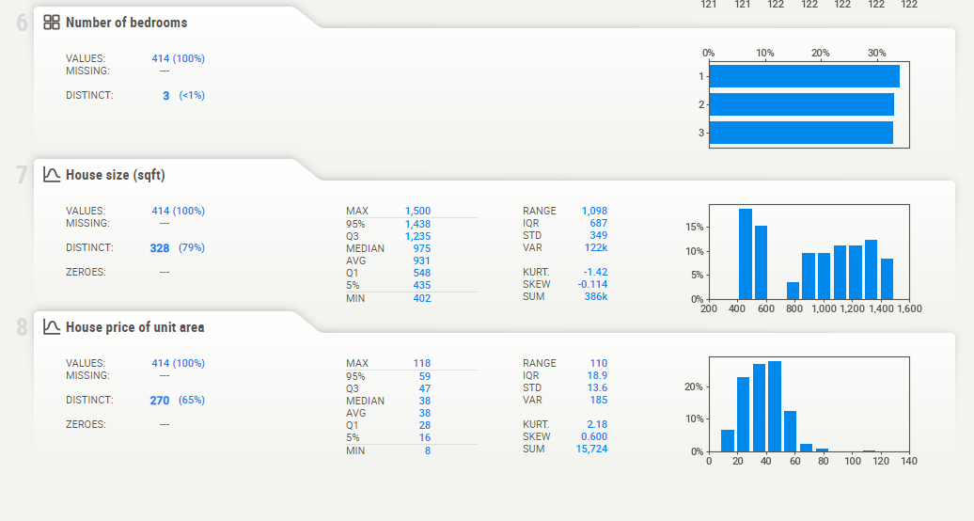

Slide 12
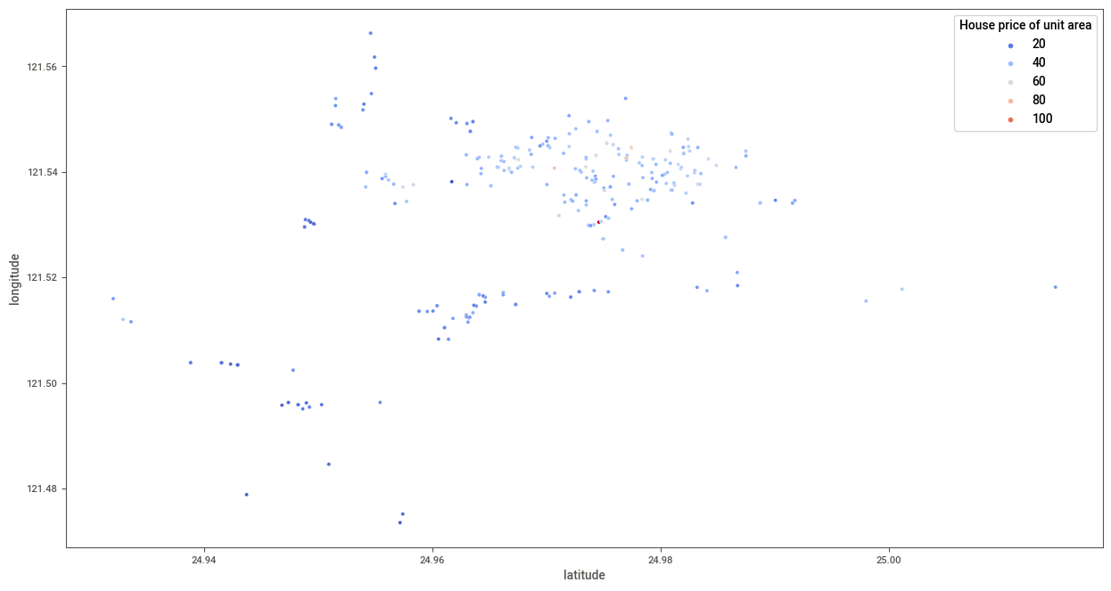
LONGITUDE & LATITUDE VS HOUSE PRICE OF UNIT AREA

Slide 13
CONCLUSION :
From the ‘LONGITUDE & LATITUDE VS HOUSE PRICE PER UNIT AREA’ its pretty clear that the Average House Price is Higher in the area from ‘121.52’ & ‘24.96’ to ‘121.56’ & ‘25.00’ as Compared to other area.

Slide 14

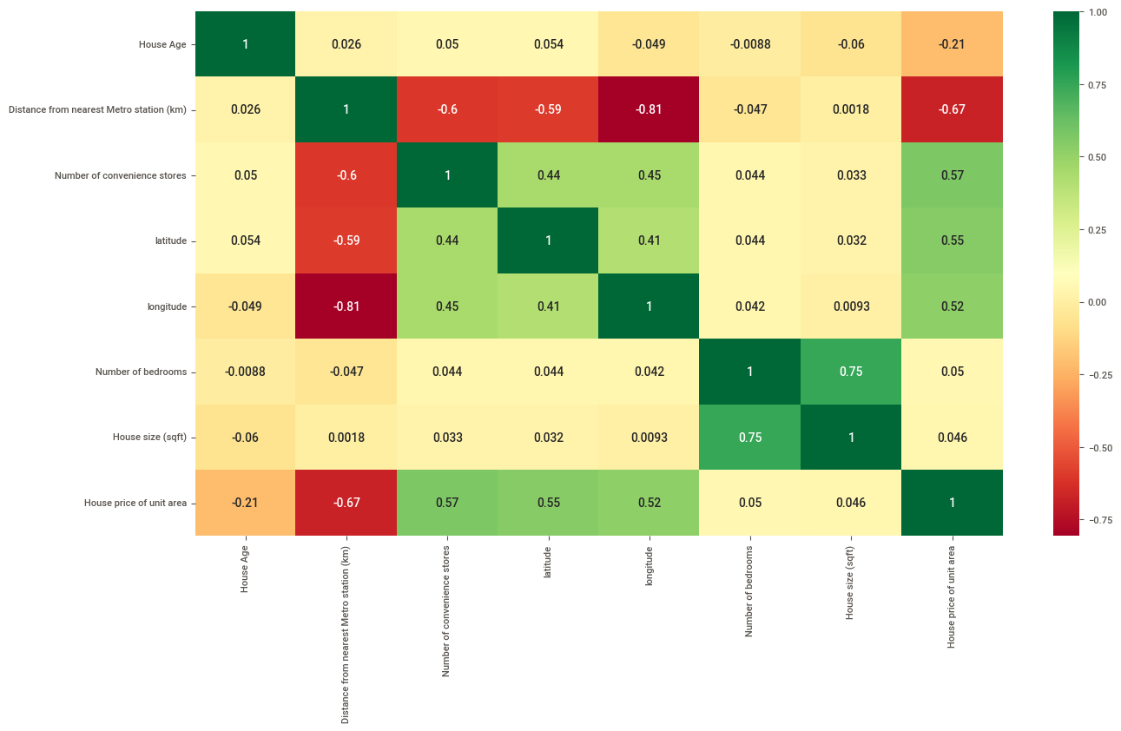
CORRELATION HEATMAP

Slide 15
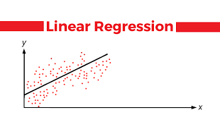
MODEL FITTING
1. LINEAR REGRESSION :
Linear-regression models have become a proven way to scientifically and reliably predict the future. Because linear regression is a long-established statistical procedure, the properties of linear-regression models are well understood and can be trained very quickly.
By fitting Linear Regression on our data I got 665 accuracy which is good but not satisfactory. So I fit Random Forest model for better accuracy.

Slide 16
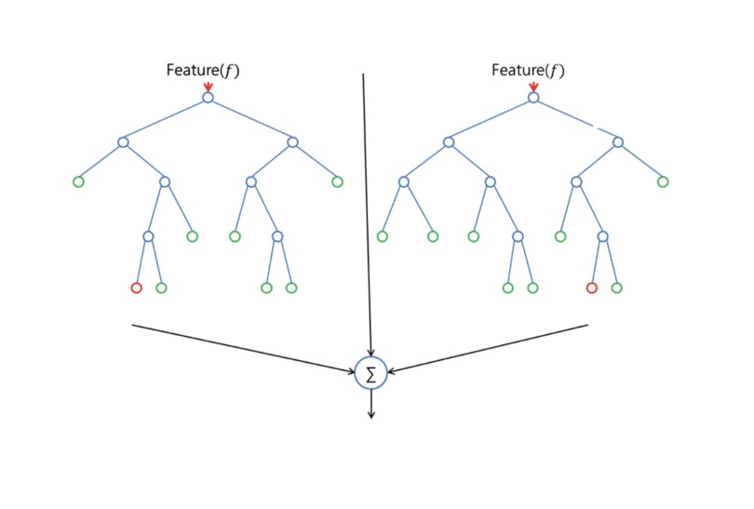
2. RANDOM FOREST :
Random forest adds additional randomness to the model, while growing the trees. Instead of searching for the most important feature while splitting a node, it searches for the best feature among a random subset of features. This results in a wide diversity that generally results in a better model.
After fitting the Random Forest Model on Data I got 80% Prediction Accuracy which is better than our previous model.

Slide 17
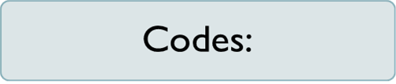
import numpy as np
import pandas as pd
import matplotlib.pyplot as plt
import sklearn as svm
import seaborn as sns
data = pd.read_excel("/content/DS - Assignment Part 1 Cleaned data set.xlsx")
df = pd.DataFrame(data = data)
df.describe()
df.shape

Slide 18
EDA
print('Transaction Year')
print(df["Transaction Year"].value_counts())
sns.countplot(x='Transaction Year', data = df , palette = 'Set1’ )
df = df.drop(['Transaction Year'], axis = 1)
df
!pip install sweetviz
import sweetviz as sv report = sv.analyze(df) report.show_html("./report.html")

Slide 19
plt.figure(figsize = (15,8))
sns.scatterplot(x="latitude", y="longitude", data = df, hue = "House price of unit area", palette="coolwarm")
plt.figure(figsize = (15, 8))
sns.heatmap(df.corr(), annot =True, cmap = 'RdYlGn’)
df.head()

Slide 20
TRAIN TEST SPLIT
# Dependent Variable
y = df.iloc[:,-1].values
df.drop(labels=['House price of unit area'], axis = 1, inplace = True)
x = df.iloc[:,:]
from sklearn.model_selection import train_test_split
x_train, x_test, y_train, y_test = train_test_split(x, y, test_size=0.20, random_state=42)

Slide 21
##Linear Regression Model Fitting
#Importing Model
from sklearn.linear_model import LinearRegression
reg = LinearRegression()
reg.fit(x_train, y_train)
#Model Prediction
y_predict = reg.predict(x_test)
#Model Accuracy
from sklearn.metrics import r2_score
r2_score(y_test, y_predict)*100

Slide 22
# Adding Own Data
inp = np.array([18, 280, 8, 24.9798, 121.5395, 2, 1200])
inp = inp.reshape((1, -1))
reg.predict(inp)

Slide 23
## Random Forest Model Fitting
# Importing Model
from sklearn.ensemble import RandomForestRegressor
model = RandomForestRegressor()
model.fit(x_train, y_train)
# Model Prediction
y_pred = model.predict(x_test)
# Model Accuracy
from sklearn.metrics import r2_score
r2_score(y_test, y_pred)*100

Slide 24
# Adding Own Data
inp = np.array([18, 280, 8, 24.9798, 121.5395, 2, 1200])
inp = inp.reshape((1, -1))
model.predict(inp)

Slide 25


